Slide 1
Smart Health & Fire Monitoring System Based on ESP32 and iPad Dashboard
🧠 Health + 🔥 Fire dual monitoring
📱 iPad real-time UI, 🧩 sensor fusion, 📷 event validation
T2 UNIVERSITY OF MISSOURI-KANSAS CITY
Hui Jin Apr 9, 2025
Jiarui Zhu
Changyu Liu
Yiyang Liu

Slide 2
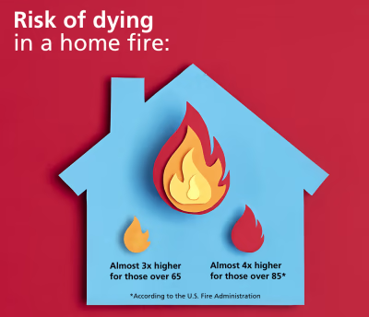
Project Overview
Why this project?
Elderly or home-alone individuals need health safety and fire warning
Existing solutions: health-only or fire-only, often lack interactivity

Slide 3

Project Overview
Propose
Combined solution (health + fire)
Real-time response
Visual UI + camera validation
Low-cost & scalable

Slide 4
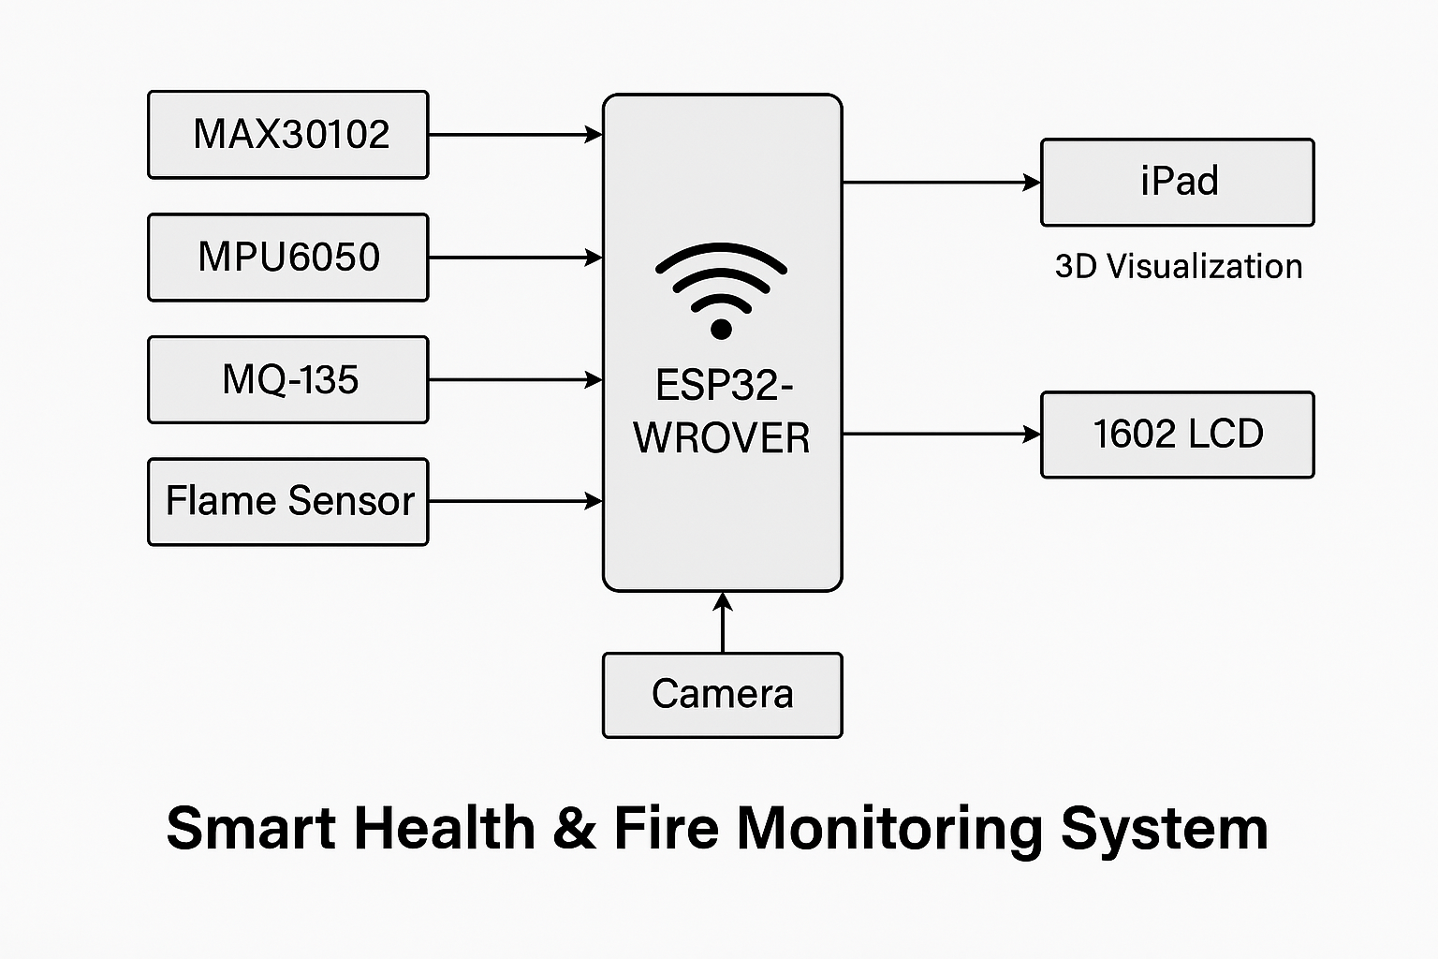
System Architecture Diagram
Sensing Layer: Sensors + ESP32
Processing Layer: Data parsing, fall/fire detection
Application Layer: iPad dashboard Communication: Wi-Fi Event Flow: Sensor → ESP32 → iPad → UI alert/image

Slide 5
Hardware Components
Component | Description
ESP32-WROVER | Wi-Fi, PSRAM, OV2640 camera
MAX30102 | Heart rate + SpO₂ detection
MPU6050 | Fall + posture detection (6-axis IMU)
MQ-135 | CO₂, CO, NH₃ air quality
Flame Sensor | Fire detection via infrared
OV2640 Camera | 2MP photo on abnormal event
1602 LCD | On-site health/fire display

Slide 6
Software Architecture (ESP32 side)
Loop reads all sensors
Fall detection via angle/acceleration threshold
Fire detection via gas + flame
JSON formatting: {"HR": 78, "SpO2": 96, "Air":"Good", "Posture":"Bad"}
Captures & encodes camera image on event
Sends to iPad via Wi-Fi

Slide 7
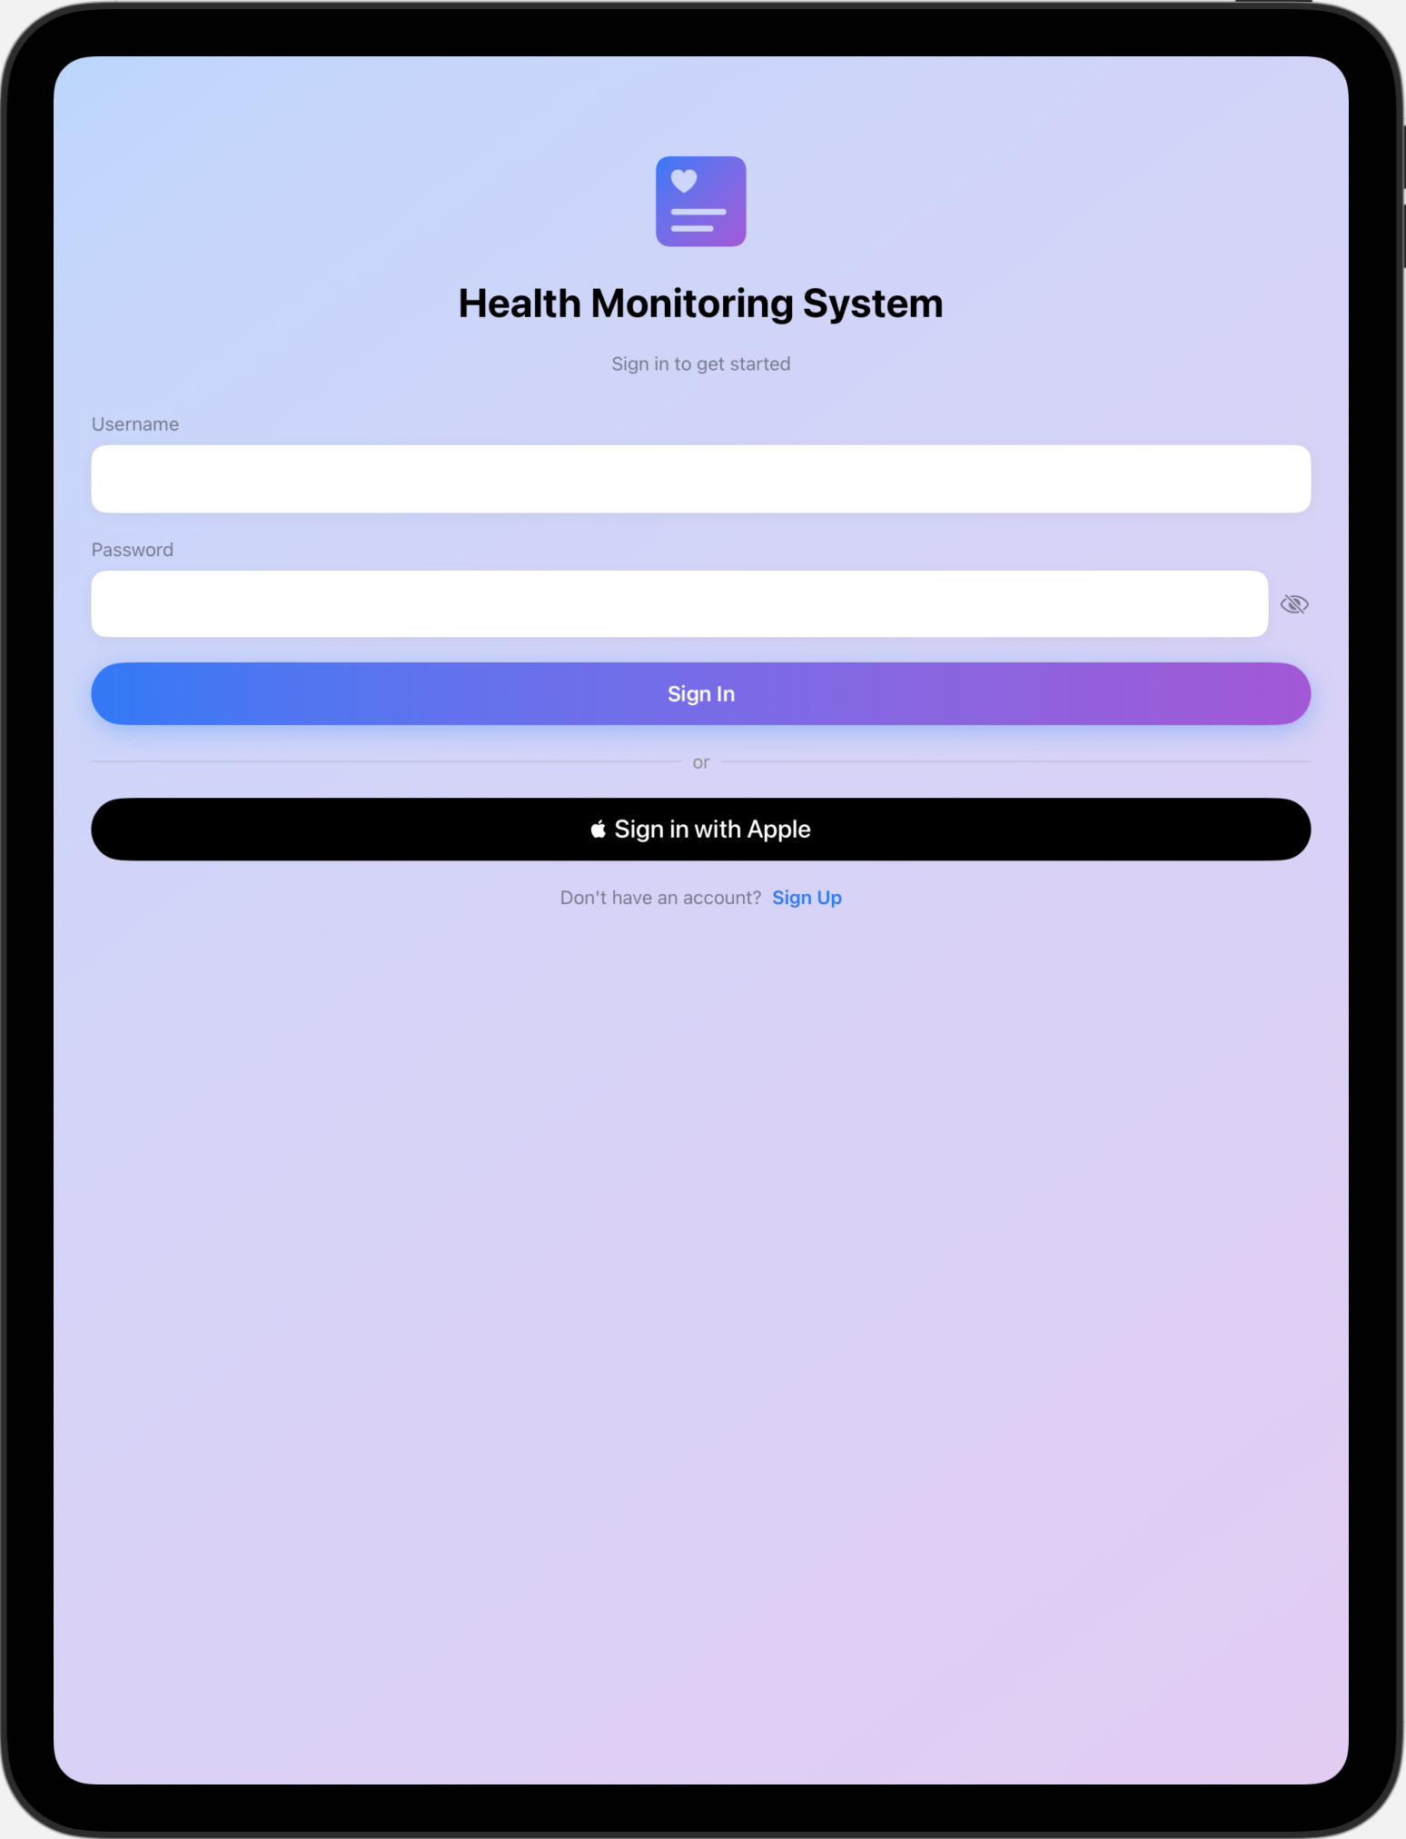

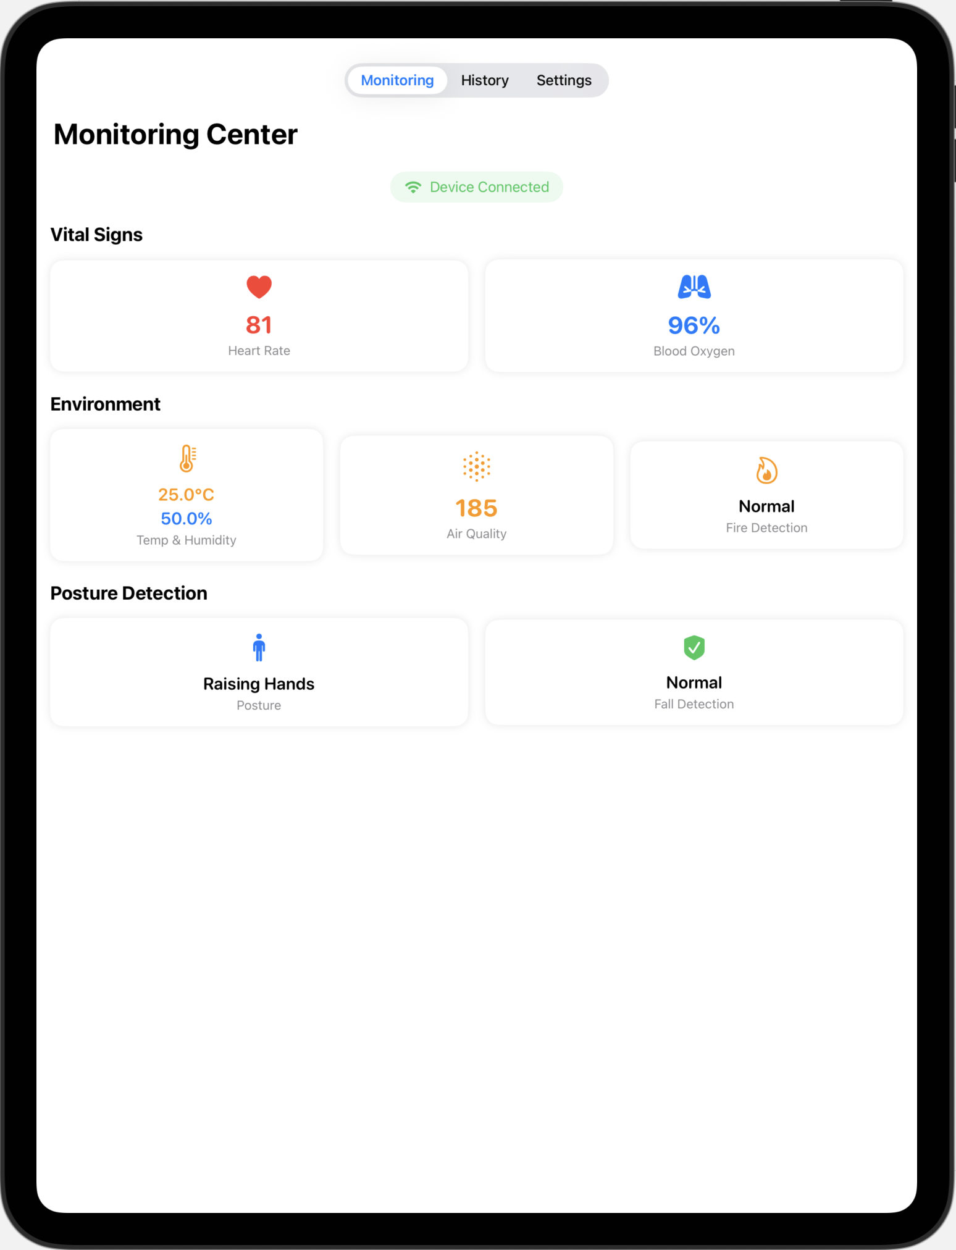
iPad UI Design

Slide 8
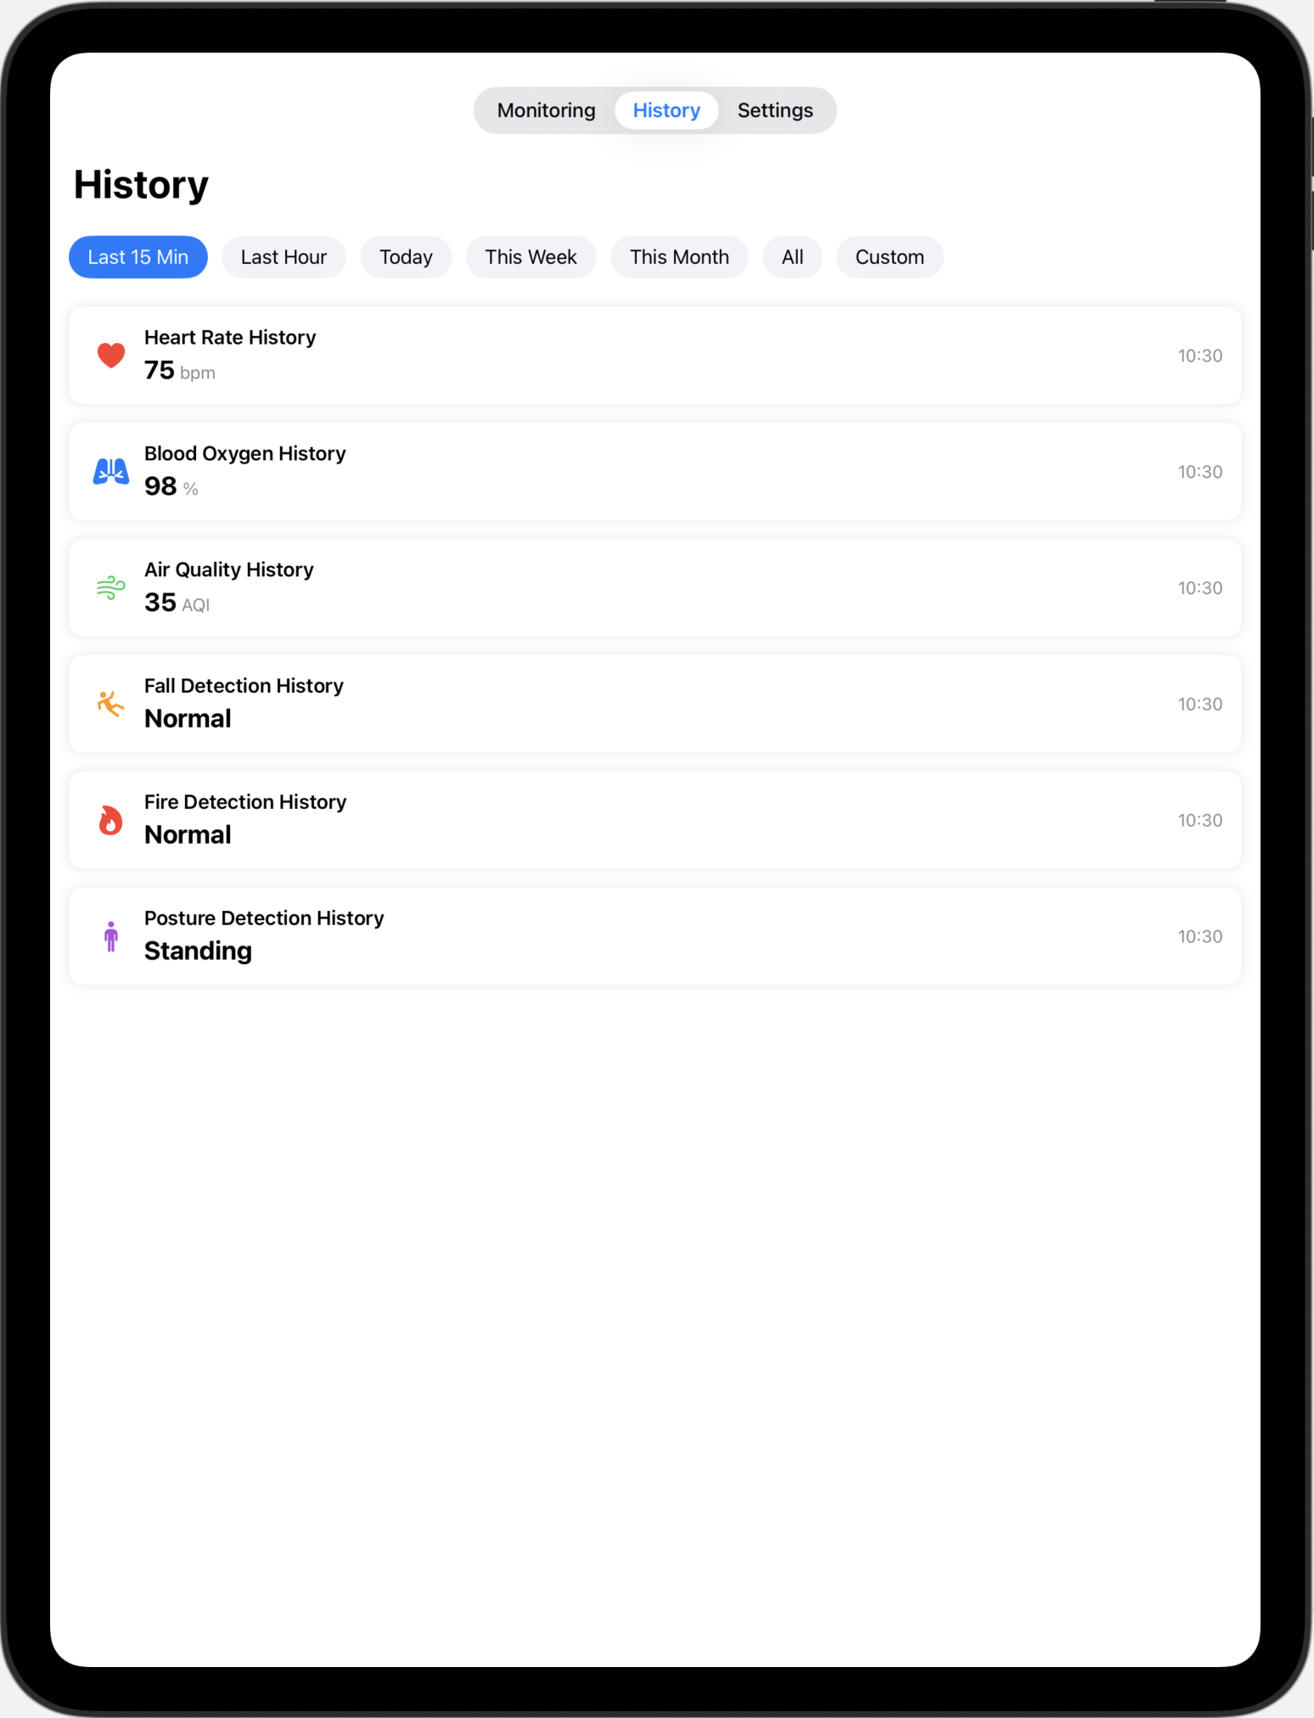
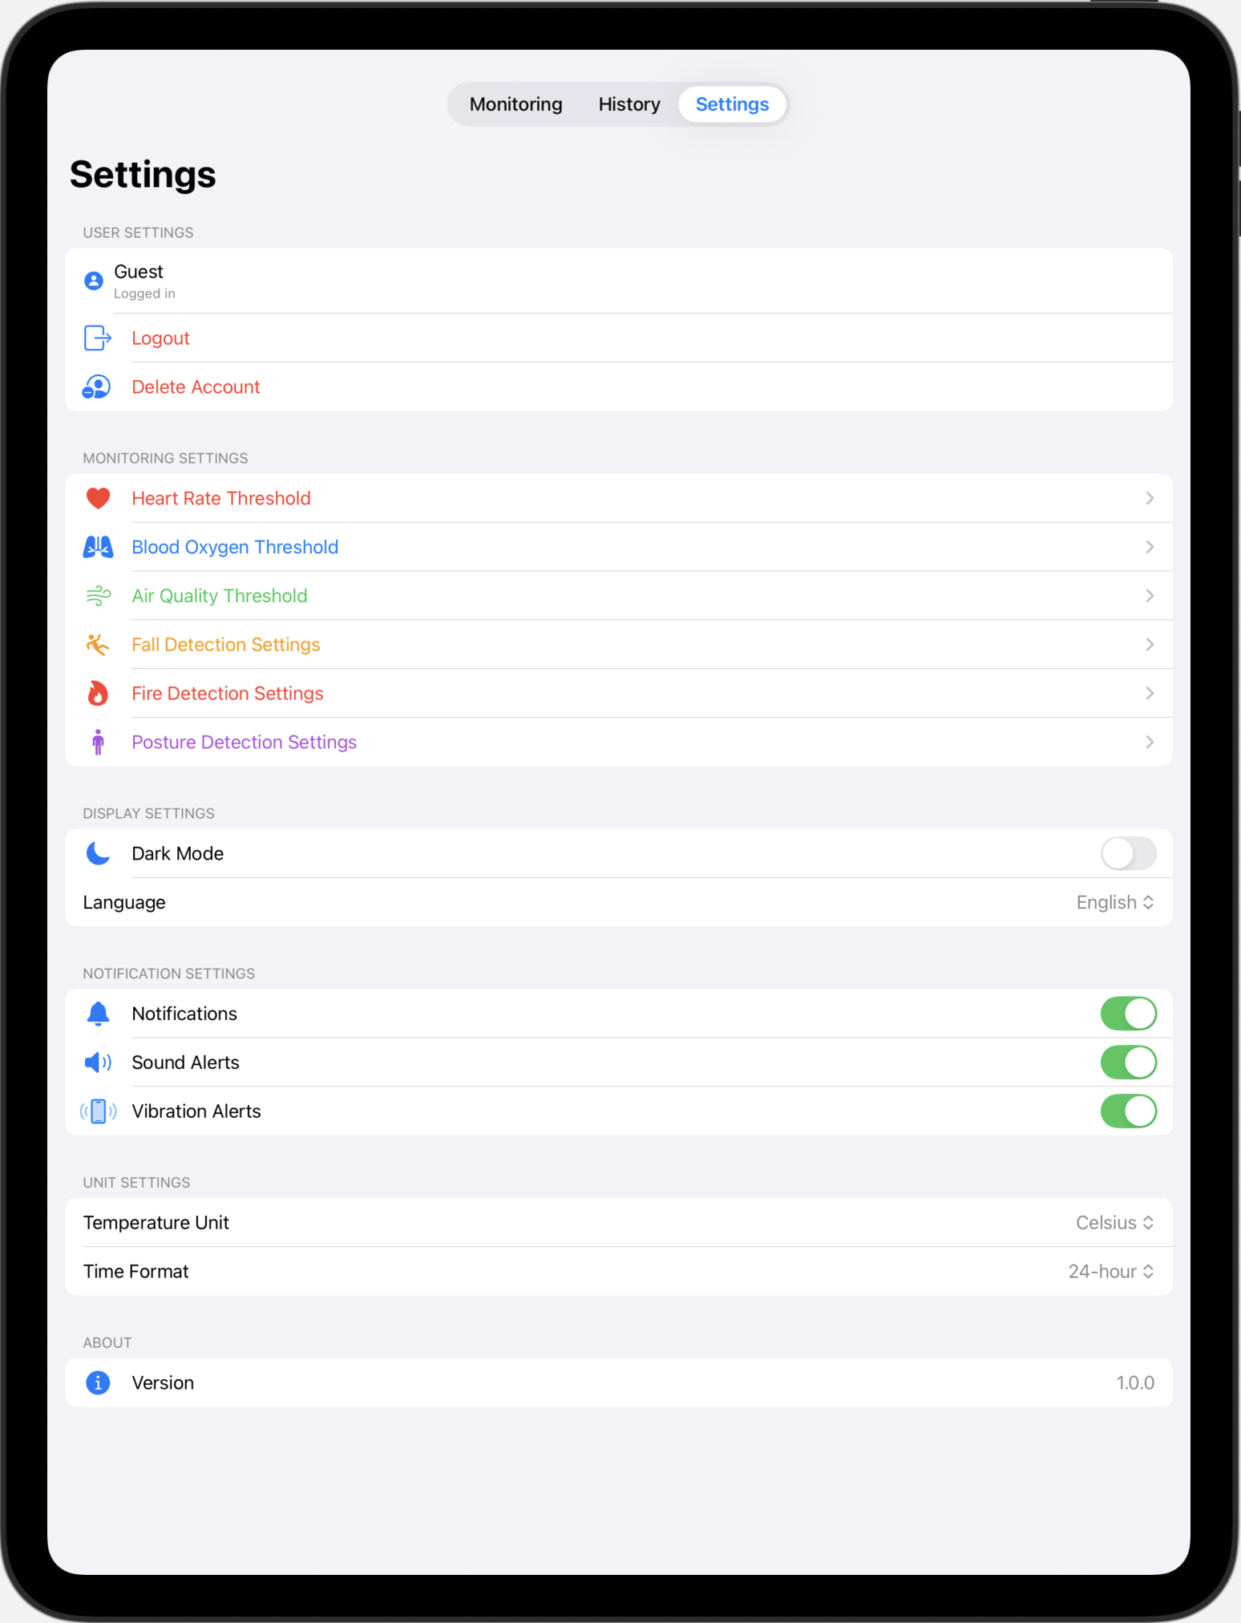
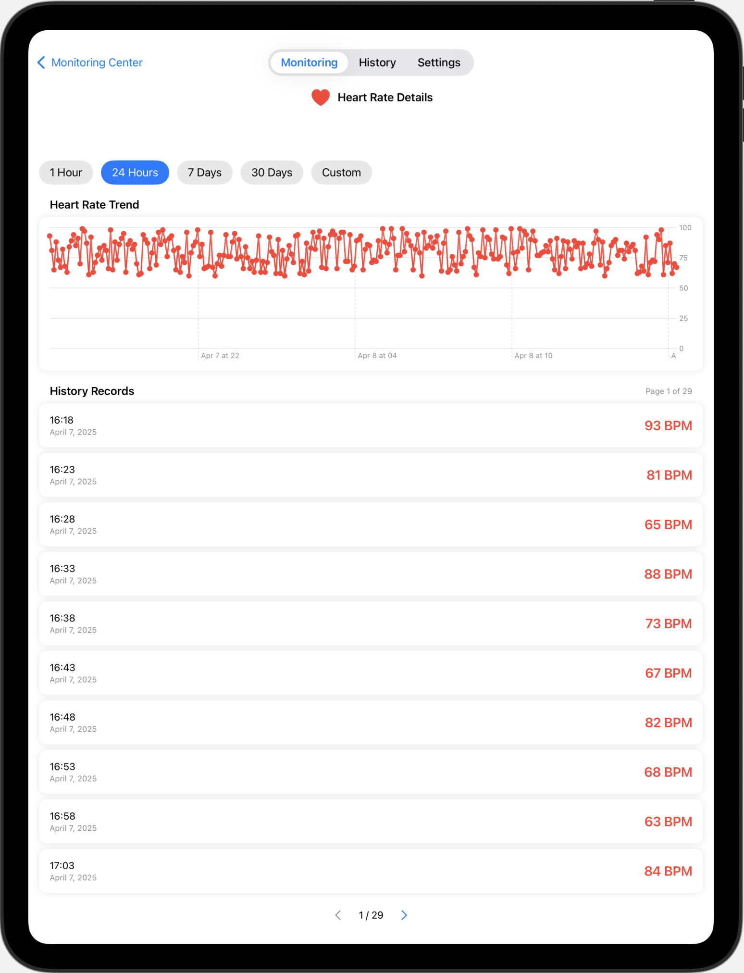
iPad UI Design

Slide 9
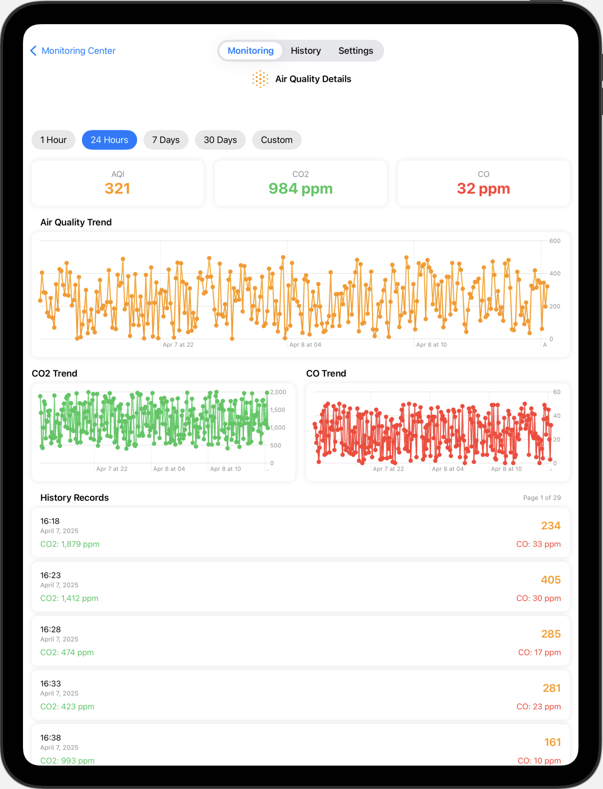
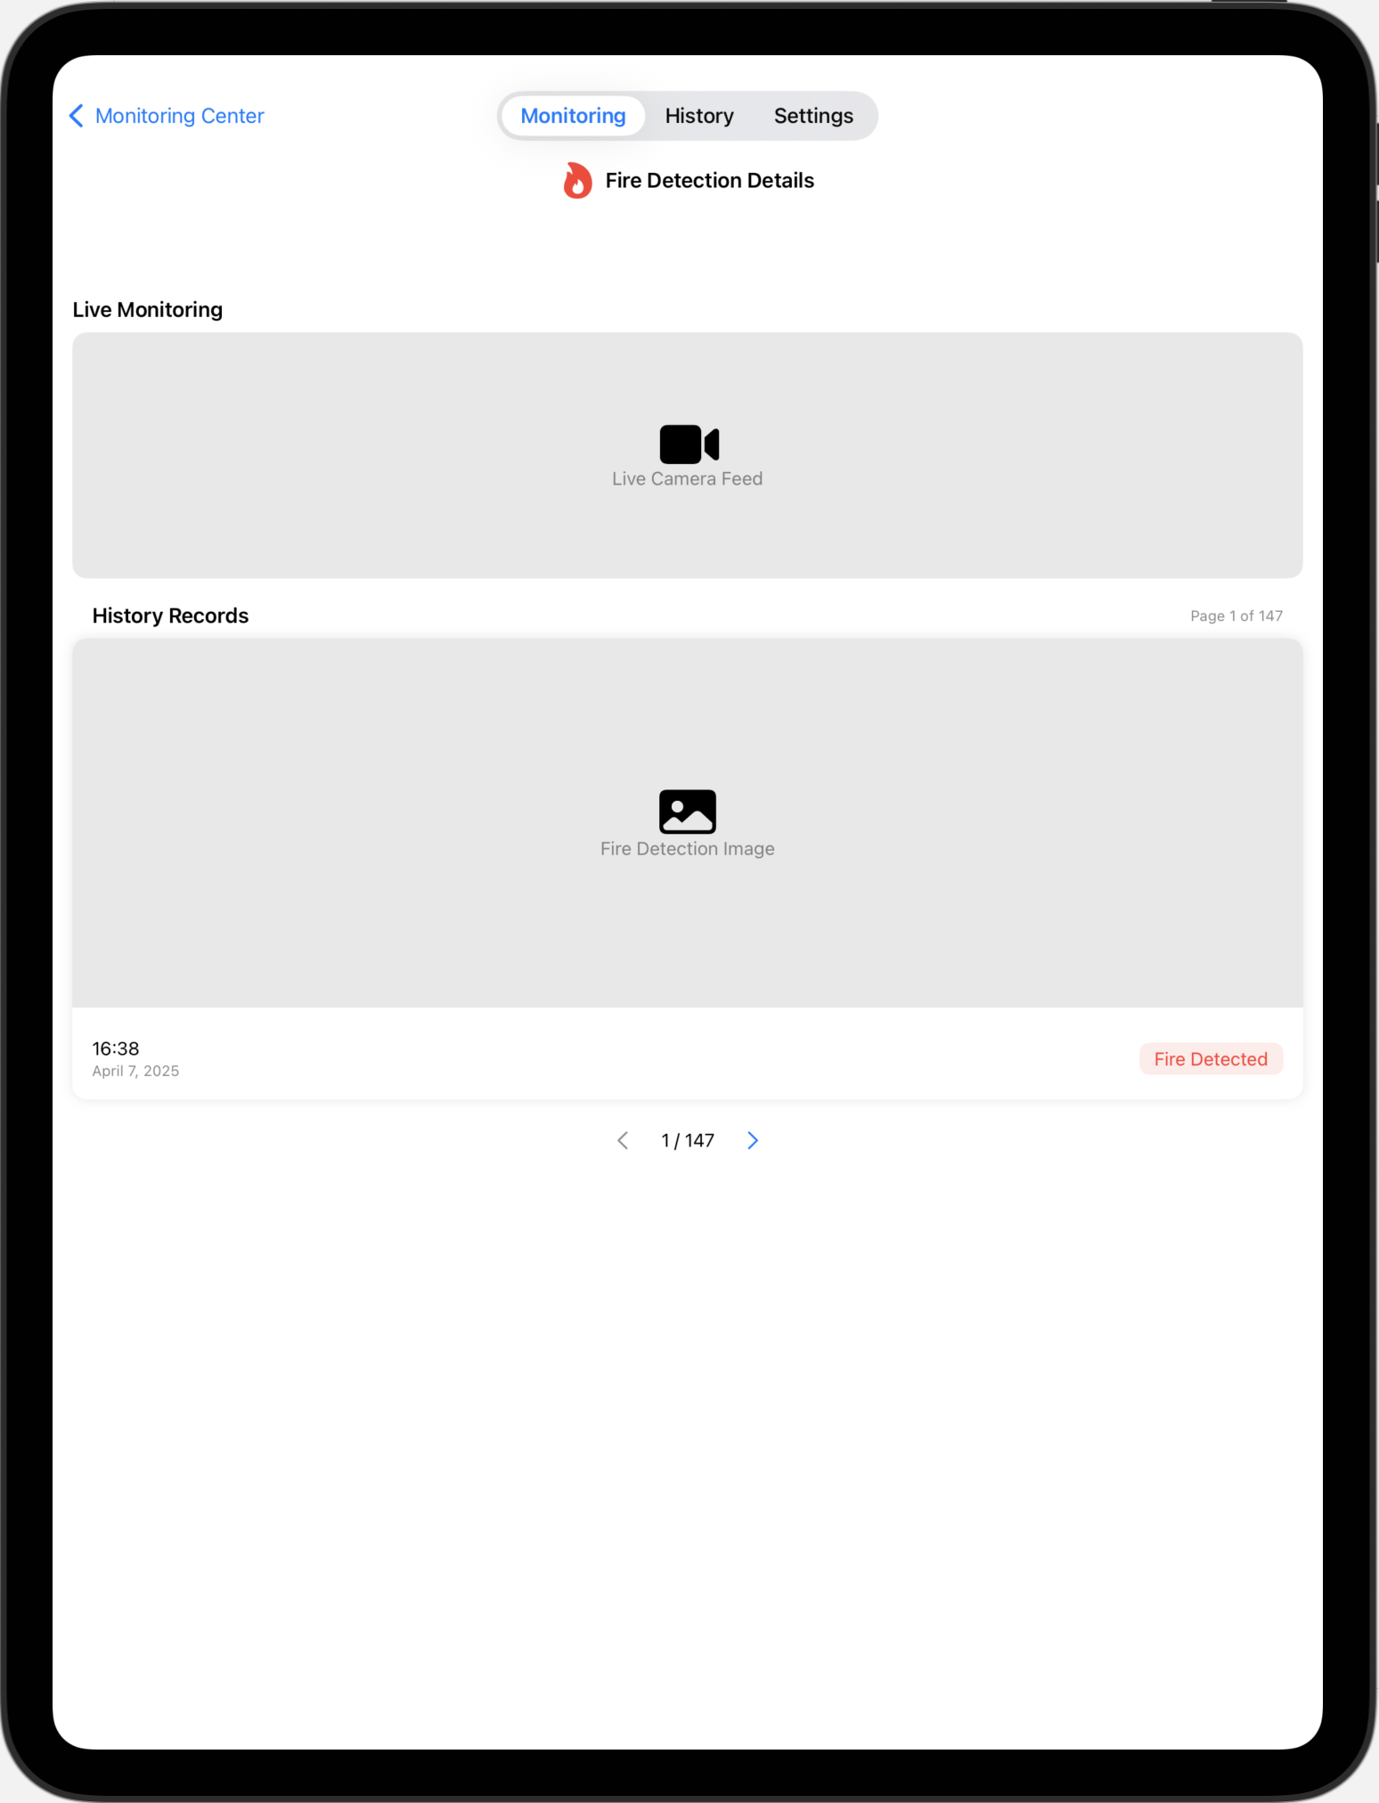
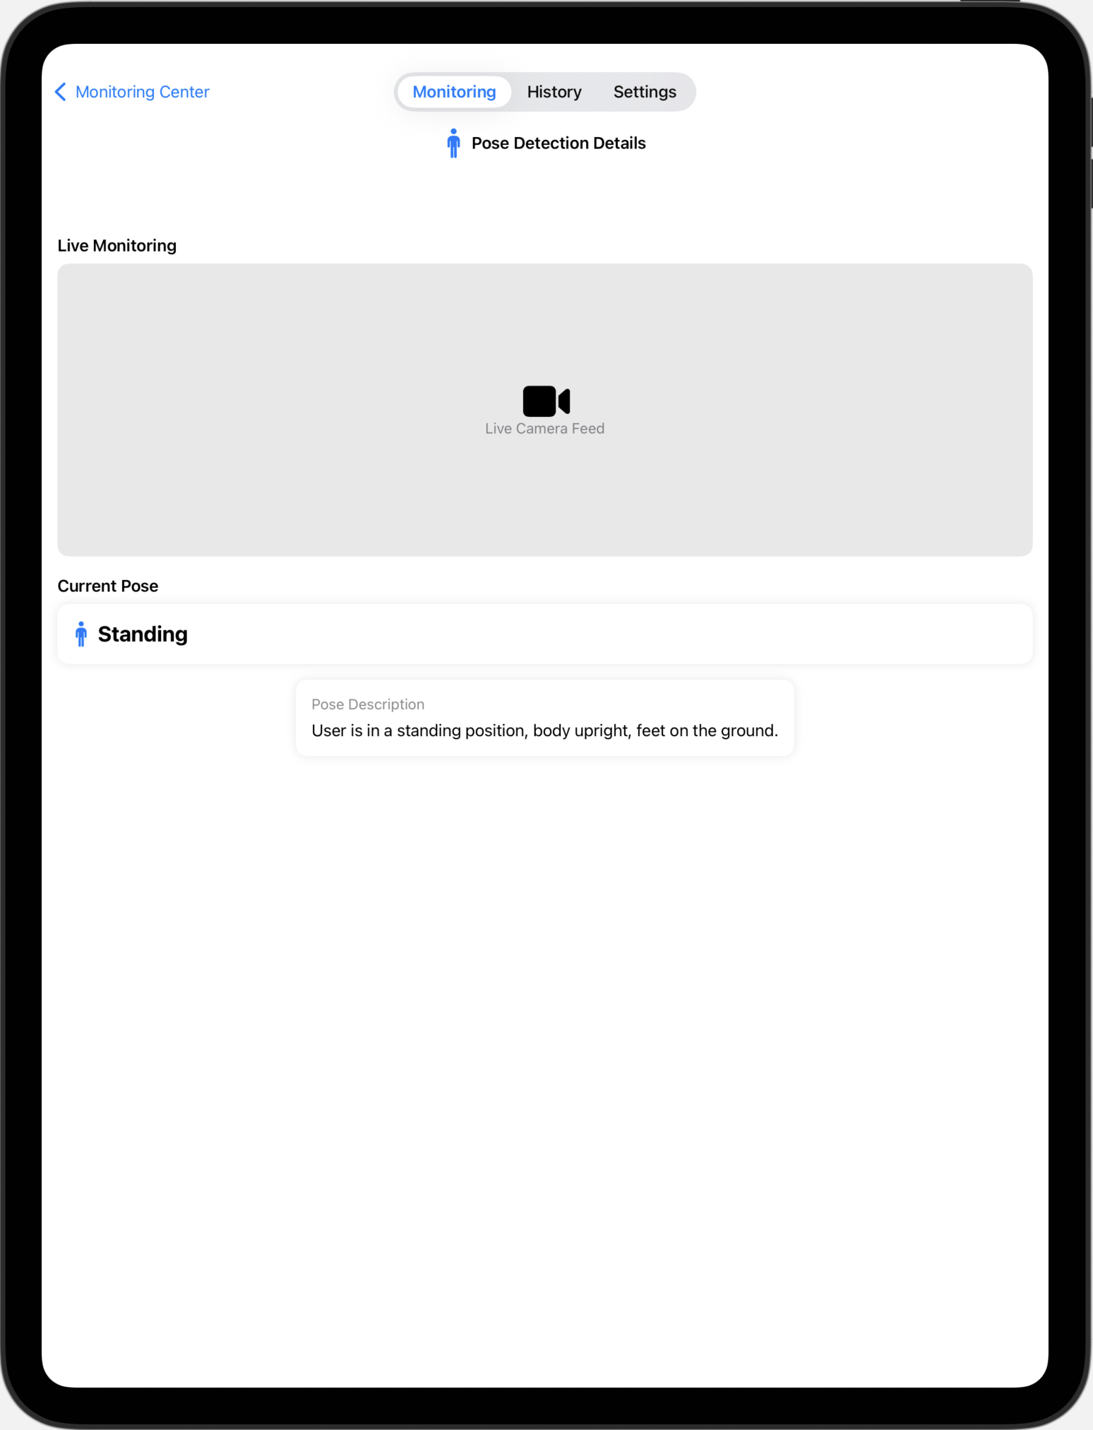
iPad UI Design

Slide 10
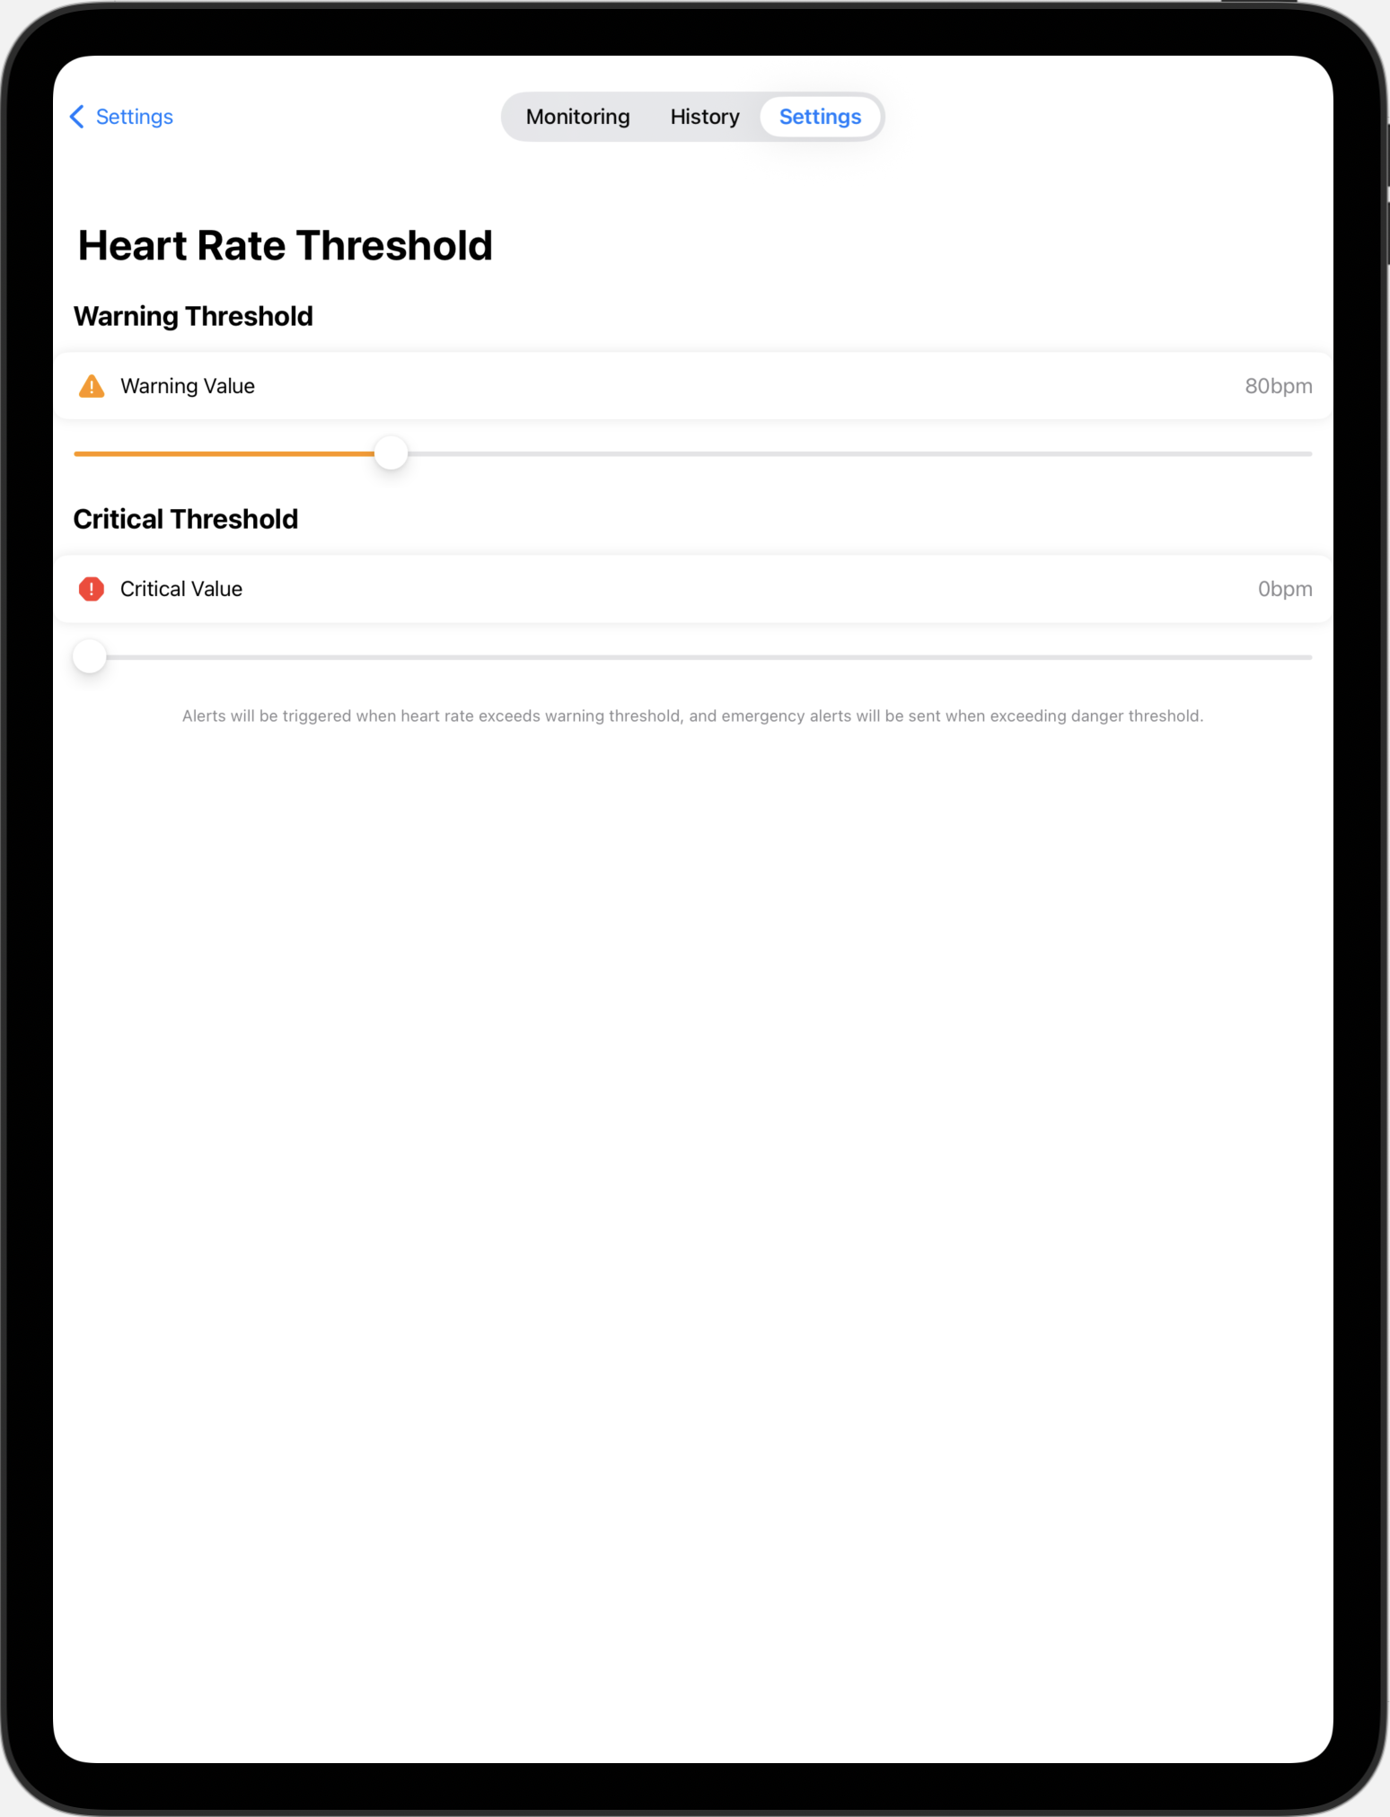
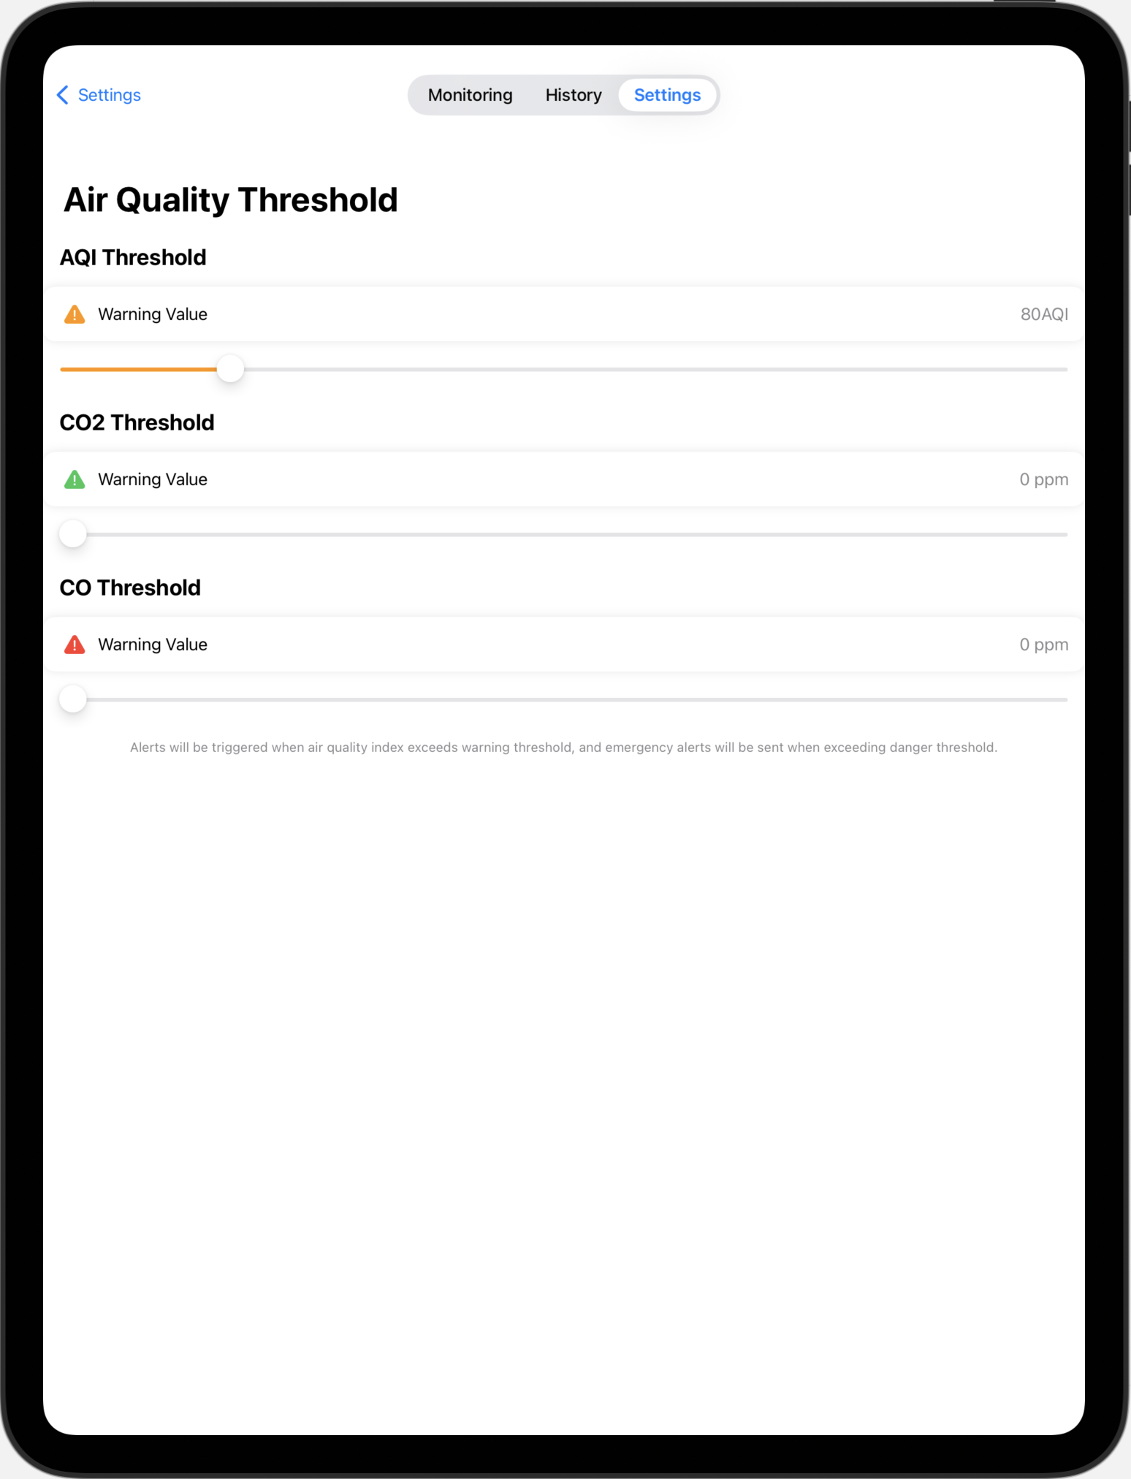
iPad UI Design

Slide 11
Functionalities
Real-time health monitoring
Fire hazard detection
Fall detection with confirmation flow
Visual/audio alerts
Camera evidence capture & transmission
iPad dashboard for caregivers/family
LCD fallback display in case of no mobile access

Slide 12
Connectivity & Security
Wi-Fi for higher data throughput (image transfer)
Event-based camera activation only
Lightweight authentication layer
Data validation (JSON schema check)
No cloud upload → Local privacy focus

Slide 13
Experimental Results & Performance
Test Case | Result
Fall detection | 92% accuracy (2 test users)
Air quality reactivity | < 5 seconds
Flame response time | < 3 seconds
Camera activation time | ~0.8 seconds
iPad alert delay | ~1.2 seconds (Wi-Fi)
⚠️ Test under different light, posture, and gas conditions

Slide 14
Conclusion & Future Work
Conclusion
Cost-effective, dual-purpose health/fire IoT system
Rich UI via iPad enhances usability
Real-time + camera-backed alerts increase reliability
Future Work
🌐 Cloud sync & caregiver alerting
🧠 AI-based fall prediction from sensor trends
📦 Integration into home automation (e.g., smart speakers)
🔋 Low-power optimization, solar extension

Slide 15
References
[1] Jung Hyun Kim, et al. Flat-Feet Prediction Based on a Designed Wearable Sensing Shoe and a PCA-Based Deep Neural Network Model. Vol. 8, 26 Oct. 2020, pp. 199070–199080.
[2] Jadhav, Kaushal. “Smart Industrial Safety Monitoring and Alert System Using Raspberry Pi.” INTERANTIONAL JOURNAL of SCIENTIFIC RESEARCH in ENGINEERING and MANAGEMENT, vol. 08, no. 03, 17 Mar. 2024, pp. 1–5.
[3] Mustiko, Beni, and Wahyu Sri. “Heart Rate Monitoring System Using Max30102 Sensor and Gaussian Naive Bayes Algorithm.” International Journal of Computer Applications, vol. 185, no. 47, 23 Dec. 2023, pp. 7–12.
[4] Zeng, Ziyang, et al. Human Fall Detection Algorithm Based on Random Forest and MPU6050. 19 Feb. 2024, pp. 79–79.
[5] Mahassa, Arie Ramdhiani, et al. “The Effect of Routine Gymnastics toward Post-Exercise Heart Rate Recovery in Elderly.” Indonesian Journal of Cardiology, 28 May 2020.
[6] Kumar V., Jagadeesh, and K. Ashoka Reddy. “Pulse Oximetry for the Measurement of Oxygen Saturation in Arterial Blood.” Studies in Skin Perfusion Dynamics, 2021, pp. 51–78.
[7] Melillo, Paolo, et al. “Wearable Technology and ECG Processing for Fall Risk Assessment, Prevention and Detection.” Annual International Conference of the IEEE Engineering in Medicine and Biology Society. IEEE Engineering in Medicine and Biology Society. Annual International Conference, vol. 2015, 2015, pp. 7740–7743.
[8] Wiertel, Piotr, and None Maria Skublewska-Paszkowska. “Comparative Analysis of UIKit and SwiftUI Frameworks in IOS System.” Journal of Computer Sciences Institute, vol. 20, 30 Sept. 2021, pp. 170–174.

Slide 16
Thanks for Watching!
T2
Hui Jin
Jiarui Zhu
Changyu Liu
Yiyang Liu

